Slide 1
Product Lifecycle Management (PLM) Architecture Introduction
Notes:
Welcome to the e-Learning: ”PLM Architecture Introduction”.
Here we will describe the target architecture of the Product Lifecycle Management or PLM domain at Volvo Group. We will also try to put it into a business context showing what challenges the business faces and explain the transition from the current As-Is architecture to the future To-Be architecture.

Slide 2
What is PLM?
PLM Target Architectrure
Transition from As-Is to To-Be
The Business Challenges and Strategy
Notes:
Let’s look at the content of this e-learning.
We will start off to explain how Product Lifcycle Managment is defined at Volvo Group.
Then we describe the challenges that the business is facing and both the business and IT strategy of the PLM domain.
In the third chapter we explain the target architecture of the PLM domain.
After this we will look into the transition taking us from the As-Is to the To-Be architecture.

Slide 3
What is PLM?
PLM Target Architectrure
Transition from As-Is to To-Be
The Business Challenges and Strategy

Slide 4
Definition of PLM (from the Volvo Group IT Strategy 2011-2013)
A2 – PLM Architecture Introduction
What is PLM?
Conception
Service & Disposal
…the process of managing the entire lifecycle of a product
Manufacturing
Design
Sales
PLM Product Lifecycle Management
Notes:
So what is Product Lifecycle Management or PLM anyway?
Generally it is seen as the process of managing the entire lifecycle of a product. [0]
In the Volvo Group IT Strategy 2011 to 2013, PLM is defined as the process of managing the entire lifecycle of a product, from its [1] conception, [2] through design, [3] sales [4] and manufacturing, [5] to service and disposal.

Slide 5
PLM – Spans across the mega processes
A2 – PLM Architecture Introduction
What is PLM?
DVP
MAS
DCL
PRD
BA
PLM
Product Information
SCM
Material and Supply Information
CLM
Customer Information
BA
Finance and HR Information
PLM Product Lifecycle Management SCM Supply Chain Management
CLM Customer Lifecycle Management
BA Business Administration
DVP Develop Product & Aftermarket Product Portfolio
MAS Market & Sell Total Offer
DCL Deliver & Develop Customer Loyalty
PRD Produce & Distribute Products
Notes:
[1] PLM is also an information domain and the product information spans across all the mega processes of the Volvo Group.
This way PLM provides a product information backbone for the Volvo Group and integrates people, data, processes and business systems.
[2] Apart from PLM there are three other top information domains, Supply Chain Management, Customer Lifecycle Management and Business Administration.

Slide 6
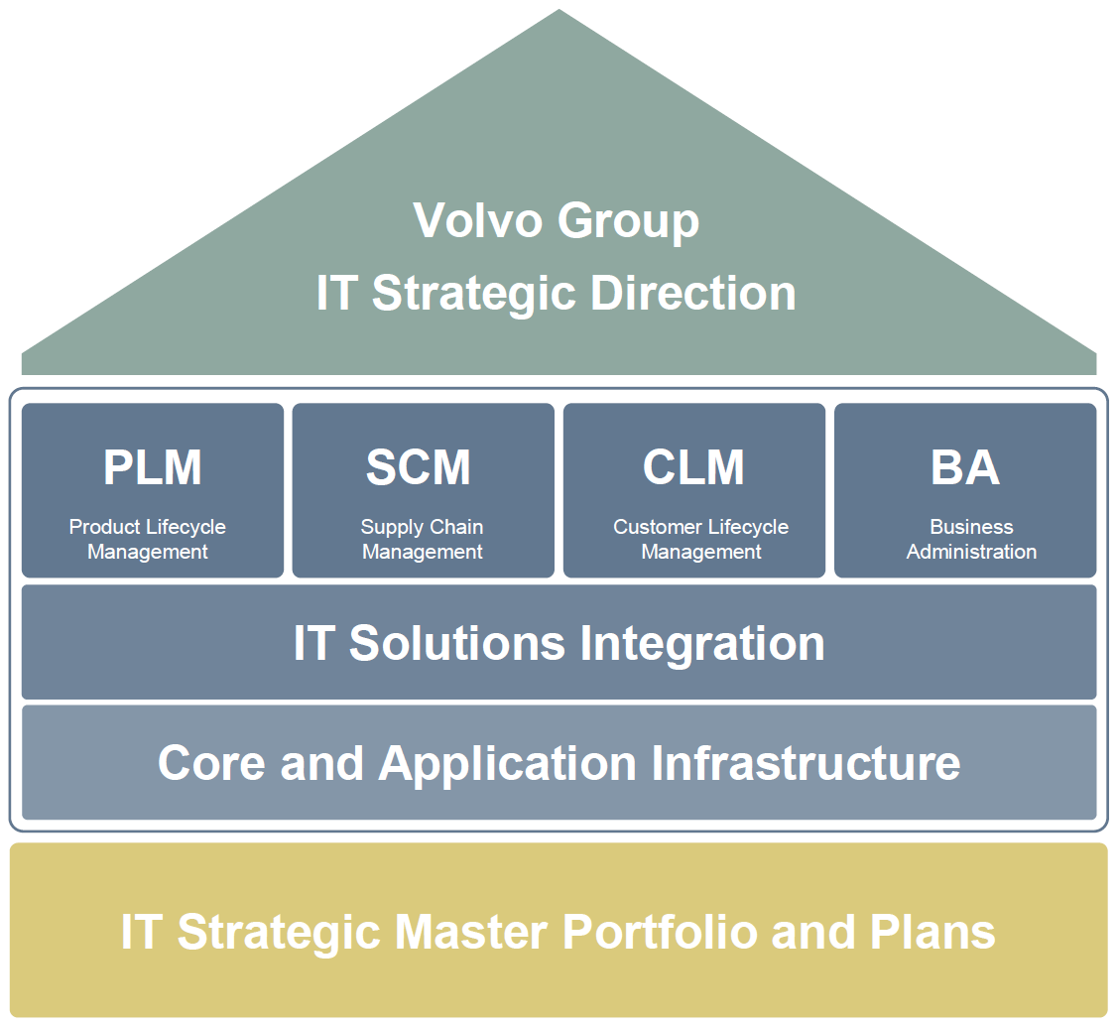
PLM - One of four Domains in the Volvo Group IT Strategy
A2 – PLM Architecture Introduction
What is PLM?
* Valid 2011-2013
Notes:
The picture shows the structure of the Volvo Group IT Strategy 2011-2013 where PLM is one of four domains.
The strategy points out that Product information must be used as an asset in all processes and that it is key to secure transparent and accurate information across the organization.
The strategy is divided into four main areas to be able to cover the key information flows. Information domain areas dictate how to build solutions and should ensure delivery of increased efficiency and value to the business.

Slide 7
What is PLM?
Transition from As-Is to To-Be
The Business Challenges and Strategy
PLM Target Architectrure

Slide 8
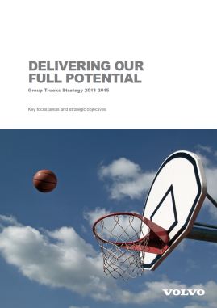





Group Trucks Strategy 2013-2015
A2 – PLM Architecture Introduction
Business Challenges and Strategy
Strategic Objectives owned by the DVP process owner:
Key strategic focus areas
1.2 Reduce actual standard cost of sales on total cost for current offer by 10%
1.5 Reduce R&D cost (spending pace) to 11.5 BSEK
2.1 We will achieve 99% product availability contributing to “strengthen customer business partnership”
4.1 Fuel efficiency to be improved by 2% per annum through vehicle optimization, diesel efficiency and electro mobility
Notes:
The Volvo Group Trucks Strategy 2013-2015 has five strategic focus areas and within these four of the strategic objectives are owned by the DVP process owner and hence are very much driving the PLM area.
[1] Strategic Objective 1.2 ”Reduce actual standard cost of sales on total cost for current offer by 10%”
[2] Strategic Objective 1.5 “Reduce R&D cost (spending pace) to 11.5 BSEK“
[3] Strategic Objective 2.1 “We will achieve 99% product availability contributing to “strengthen customer business partnership”
[4] Strategic Objective 4.1 “Fuel efficiency to be improved by 2% per annum through vehicle optimization, diesel efficiency and electromobility”

Slide 9
PLM – Business Challenges
A2 – PLM Architecture Introduction
Business Challenges and Strategy
Examples:
To set and interact the product definition at all maturity levels
To collaborate and work efficiently in and between organizational structures and networks
To efficiently build and adapt alliances
To make knowledge visible and accessible
Volvo Group IT Strategy 2011-2013
Notes:
There are many business challenges in the PLM domain, here are a few examples from the Volvo Group IT strategy 2011-2013.
[1] “To set and interact the product definition at all maturity levels”
To be able to efficiently develop new products we need to be able to define the product both in early stage of product development as well as in later stages so that it can be shared and worked jointly on.
[2] “To collaborate and work efficiently in and between organizational structures and networks”
To develop the Volvo Group products is not a one man show, we need to collaborate to succeed.
[3] “To efficiently build and adapt alliances”
Volvo needs alliances for a lot of reasons such as to gain market share and to get hold of external technology and competences.
Therefore it is important that we efficiently can manage these alliances
[4] “To make knowledge visible and accessible”

Slide 10
What is PLM?
PLM Target Architectrure
Transition from As-Is to To-Be
The Business Challenges and Strategy

Slide 11
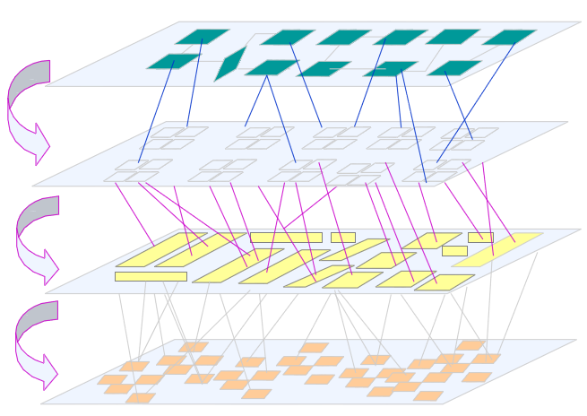
Business Requirements Drives the PLM Architecture
A2 – PLM Architecture Introduction
PLM Target Architecture
Strategic Objectives
Business Capabilities
Processes, Sub processes, Activities
Information Entities and Business Services
IT Solutions
Notes:
The target architecture for PLM is driven by business requirements, starting from the Strategic Objectives down to IT solutions.

Slide 12
What do we want to achieve with the target architecture for PLM?
A2 – PLM Architecture Introduction
PLM Target Architecture
Improve end-to-end efficiency
Flexibility to support business changes
One version of truth (Master Data approach)
Share data across processes & applications
Lower IT cost by reducing redundant integrations
Avoid costly and undesirable customizations
Notes:
We have just seen what the business challenges look like so to understand the target architecture, let us first go through what we want to achieve with it.
[1] Improve the end-to-end efficiency
Today a change in one system can take one or more days to appear in a related system dues to system chains and batch file approach. Instead we want up to date data through service oriented, event driven architecture.
[2] Flexibility to support business changes
Today tightly connected applications causes domino effects upon changes.
Instead we want Loosely coupled solutions, Solutions with clearly defined responibilities and Reusable services
[3] One version of truth (Master Data approach)
Today some applications cache data from other applications and allow modification of this data and then redistributes the changed data – acting as master of this data. Instead we should make sure that data is retrieved from the master system.
[4] Share data across processes & applications
Avoid locked-in IT solutions.
[5] Lower IT cost by reducing redundant integrations
It is more cost efficient to reuse a generic service than to create dedicated point-to-pont integrations.
[6] Avoid costly and undesirable customizations
Today upgrading many of our Commercial Off the Shelf solutions are really expensive and time consuming.
Instead we should use commercial applications the way they are designed to work.
Needed customizations should be done so that they can have their own lifecycle
To summarize this.
The AS-IS IT solutions are disharmonized with overlapping solutions and are stove pipe oriented.
The TO-BE architecture harmonizes system integrations into decoupled solutions that interact.

Slide 13

Structure of the PLM Target Architecture
A2 – PLM Architecture Introduction
PLM Target Architecture
Service-Oriented, Event-Driven Architecture
Service Bus
Publish/Subscribe Services
Message Transport (WMQ)
Canonical Message Format (VG CMF and PLM Services)
Message Routing (GimR)
Request/Reply Services
Fire/Forget Services
VG Target Architecture
Volvo Group 10 architectural principles
COTS Rules & Recommendations
Volvo Group Integration Platform
Java and Linux (preferred track)
Read more [1]
Notes:
This picture describes the structure of the PLM Target Architecture.
We will now go through the PLM target architecture.

Slide 14
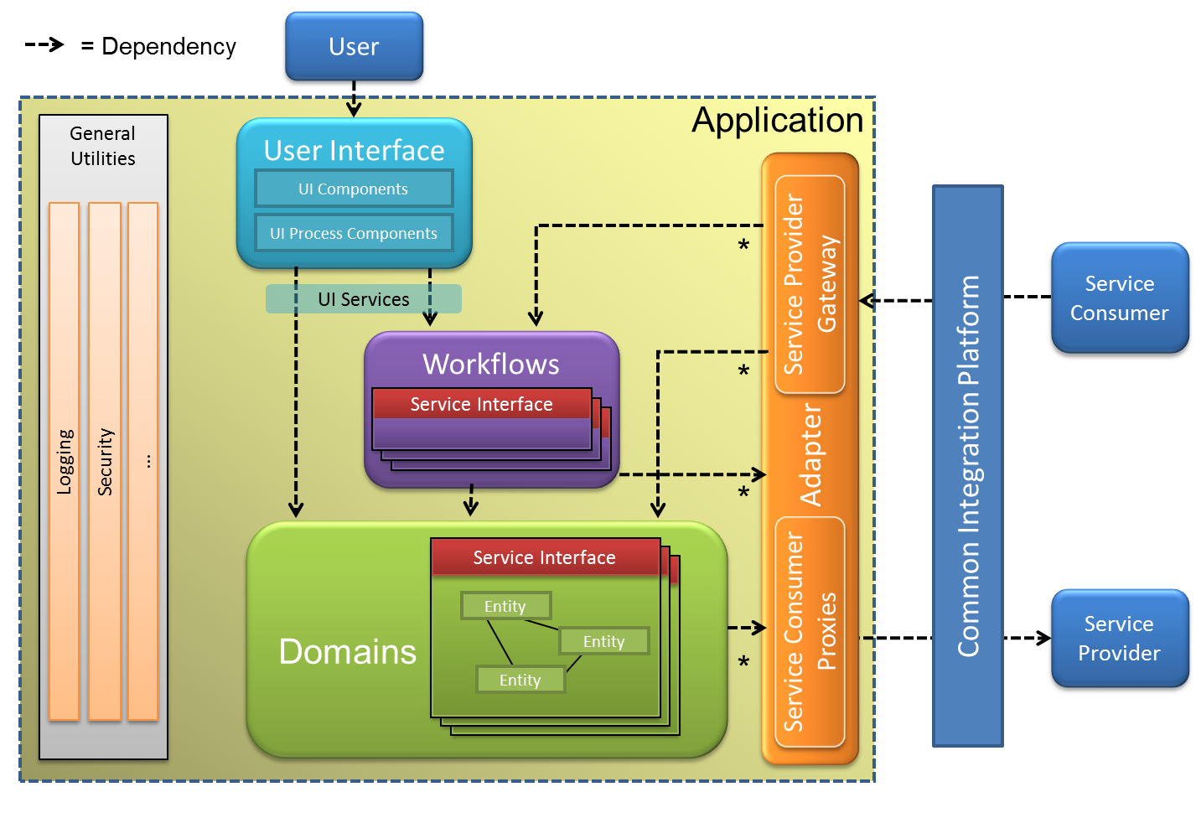


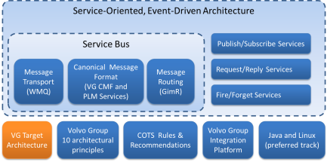
Volvo Group Target Architecture
A2 – PLM Architecture Introduction
PLM Target Architecture
Updated //Hans
Read more [2]
Notes:
[1] The Volvo Group Target Architecture is one of the foundations of the PLM Target Architecture.
It defines the application architecture and how to make use of the Volvo Group Integration Platform when integrating applications.
The main objective is to build applications with clearly separated responsibilities using a domain driven design and [2] to avoid monolithic, ”swiss army knife” approaches.
In the lower left corner there is a link icon. To get more information about the current topic place you mouse over it to see the address, or click on it to open the external reference.

Slide 15
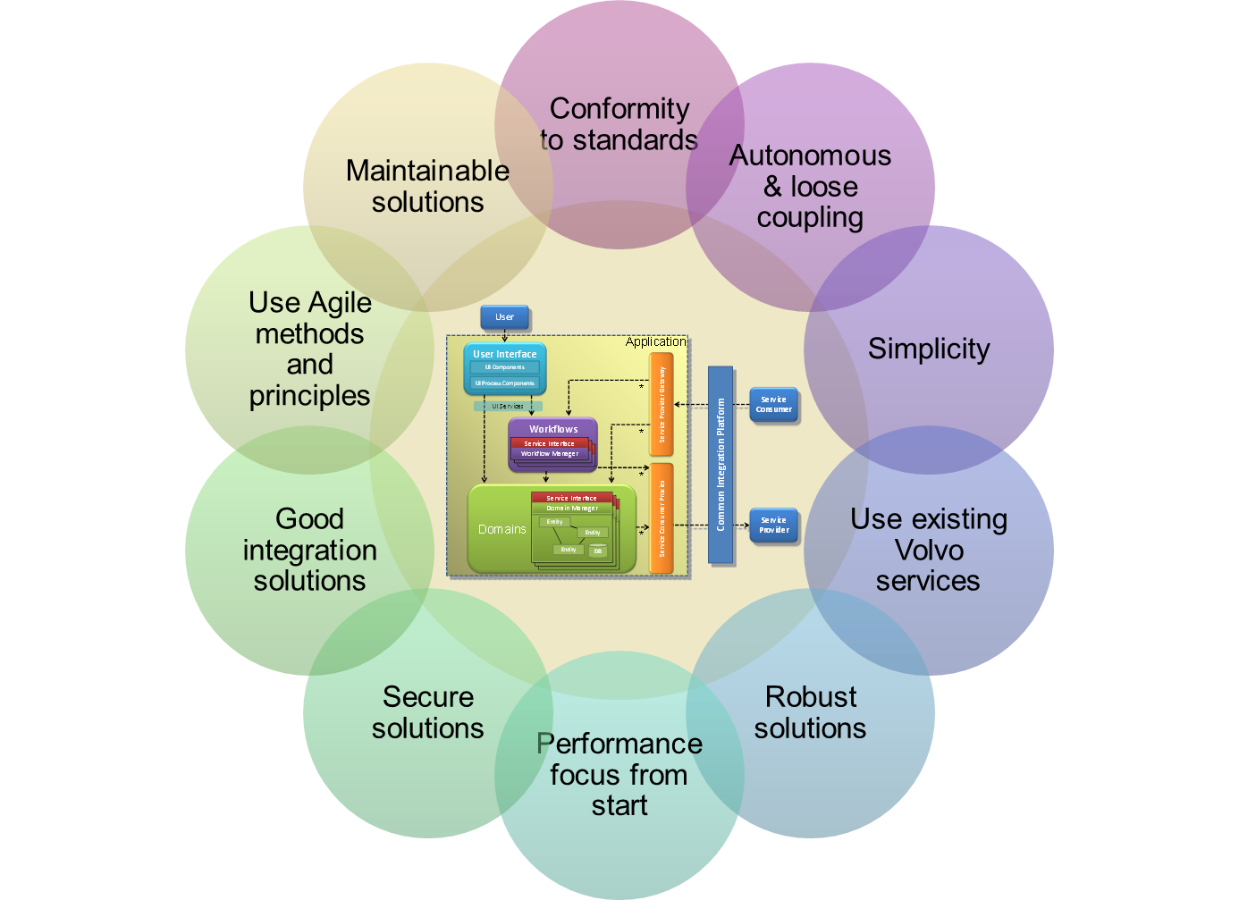
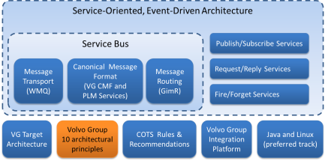
Volvo Group 10 Architectural Principles
A2 – PLM Architecture Introduction
PLM Target Architecture
Read more [3]
Notes:
[1] The “Volvo Group 10 Architectural Principles” provide guidance for architectural decisions and goes hand in hand with the Volvo Group Target Architecture. These are principles to strive for and you need to find the right balance between these sometimes competing principles.
For example a really secure and robust solution may not be the simplest one.
Let us quickly go through the principles one by one.
[2] Conformity to standards
Drive the usage of open and industry standards at Volvo.
[3] Autonomous & loose coupling between components & applications
Flexible subsystem and granular component setup, avoiding monoliths.
[4] Simplicity in solutions and work methods
Clean solutions from technical, application and user perspective. Strive for simplicity in project management and system development methods.
[5] Strive for usage of existing Volvo services
Whenever possible avoid application specific infrastructure, instead utilizing already existing services at Volvo. For example databases, application servers and brokers)
[6] Robust solutions = asynchronous, caching
Active coaching of projects to achieve robust solutions securing uptime for example right logic in the right application tier and usage of good application architecture including integration solutions. For example to avoid synchronous dependencies between applications.
[7] Performance focus from the start
Active coaching of projects to achieve good performance in solutions from the start. For example promoting test driven development, focus on database tuning early on and non-talkative messaging between UI and server.
[8] Secure solutions
Active coaching of projects to achieve secure solutions from the start. Correct functionality and data accessible to the right users. This includes usage of Volvo decided infrastructure.
[9] Good Integration solutions
Control of projects to follow the policies and guidelines decided and coach them to build the integration in the right way.
[10] Usage of Agile work methods and design principles
Control of projects to follow IS-GDP and help them use it in the best way with special focus on architecture, promoting usage of Agile system development and implementation principles.
[11] Maintainable solutions
Control of projects to deliver maintainable solutions to Maintenance.

Slide 16
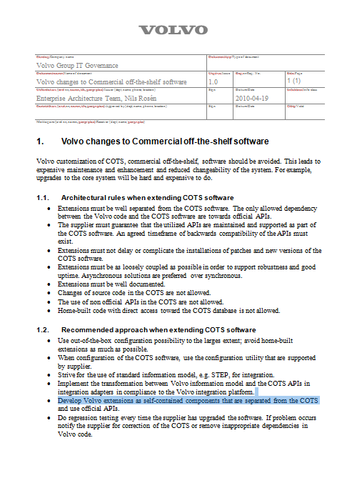
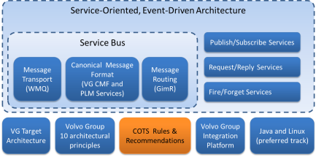
COTS Rules & Recommendations
A2 – PLM Architecture Introduction
PLM Target Architecture
Architectural Rules
Recommended Approach
Read more [4]
Notes:
The way we have implemented many Commercial Off The Shelf or COTS products at Volvo with heavy customizations is far from ideal.
It leads to expensive maintenance and reduced changeability of the system. For example, upgrades to the core system will be hard and expensive to do.
Therefore Corporate Process and IT has issued rules and recommendations for Commercial Off The Shelf or COTS products.
The document with rules and recommendations has a general statement that Volvo specific adaptation of commercial off-the-shelf software should be avoided.
[2] It states architectural rules for extending COTS software and defines a [3] recommended approach when extending COTS software.

Slide 17
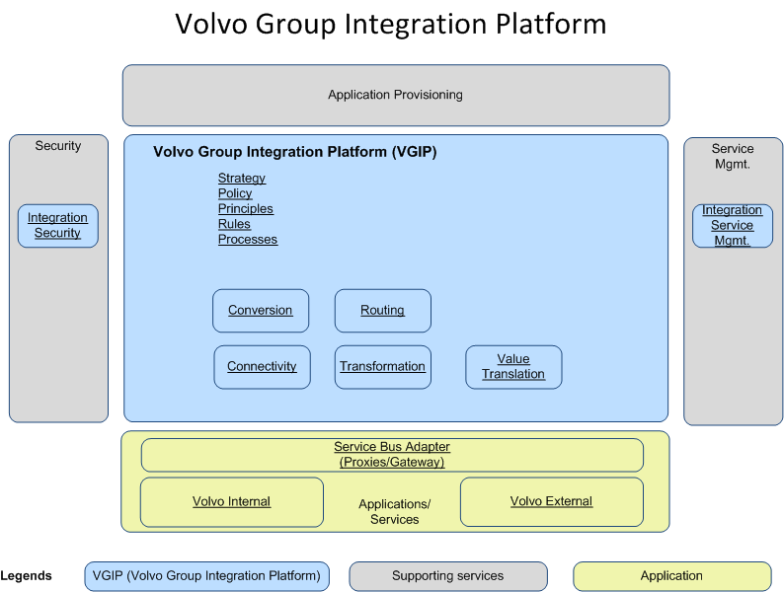


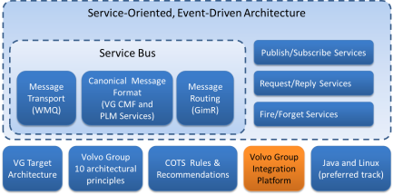
Volvo Group Integration Platform
A2 – PLM Architecture Introduction
PLM Target Architecture
Value translation
Message Transformation
Message Routing
Conversion (e.g. VCOM to MQ)
Connectivity
Read more [5]
Notes:
[1] The Volvo Group Integration Platform is a reference architecture for integration.
But it is not a “one size fits all” solution. It is very important to map requirements and needs against possible solutions.
A rule of thumb - you should never build a more complex solution than required, it is never a good business case to use technology for its own sake.
[2] The integration platform has a staircase model approach to guide us to right-sized and scalable solutions.
[3] Connectivity is used by applications to connect and use the integration platform, for example Websphere MQ and VCOM.
[4] Conversion is required when applications use different connectivity options such as VCOM and Websphere MQ.
[5] Message Routing is a mechanism to distribute messages to the intended recipients.
[6] Transformation from one format to another is required when applications use different message formats.
[7] Value translation is a function to map values in a message between two value sets.

Slide 18
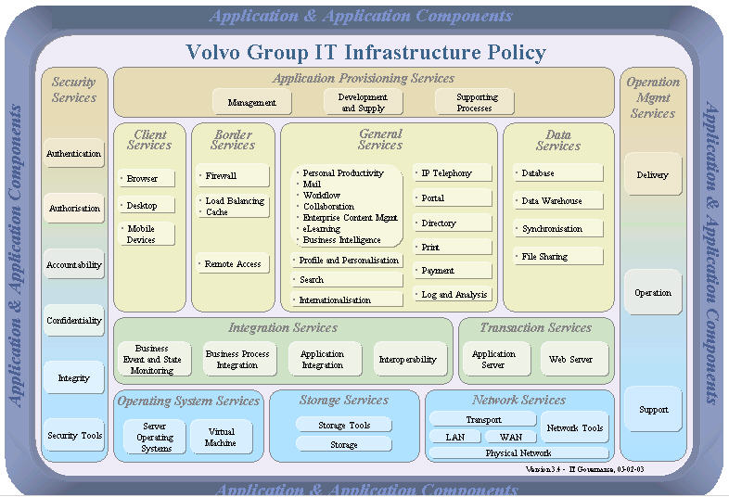
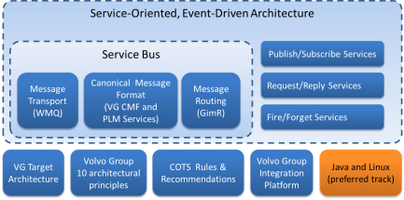
Java/Linux – Preferred Development Track for PLM
A2 – PLM Architecture Introduction
PLM Target Architecture
VIAP status:
Android
iOS
Java
.NET
SAP
MF
IBM i
SPP
Appointed
Preserving
Read more [6]
Notes:
[1]The Volvo Group IT infrastructure policy points out infrastructure technologies and components to use at Volvo.
The development tracks are extensions on top of this and each development track describes the appointed components within that track.
[2] For the PLM domain, the Java Development track and Linux is the preferred development platform.
The main reasons for this is that the Java-Linux runtime environment is more robust than .NET at Volvo. It has less frequent technological major changes, compared to the Microsoft Track which has a bad track record of costly migrations.

Slide 19
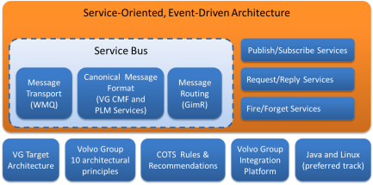
Service-Oriented, Event-Driven Architecture
Applications provide and consume services on the bus
Application A
Service Provider
Application B Service Consumer
PLM Service Bus
WebService based Service Oriented Architecure
Application C Service Consumer
Service Bus Approach
Sharing of data via publish/subscribe services
Reuse of logic via request/reply services
Notes:
[1] The PLM target architecture is a so called Service-Oriented, Event Driven Architecture.
[2] This means that applications [3] provide and consume services on a service bus in a loosely coupled way.
The event driven architecure is achieved by letting applications publish event messages when data is changed inside the applications using a publish-subscribe integration pattern.
Logic can be reused by using a request-reply service were applications sends a request and asyncronously get a response.
We will talk more about messages and the service bus in a moment.
[3] The service bus with all the services that applications expose on it, enables quick and easy sharing of data between applications and resuse of business logic.
[4] Note that this is not a Service Oriented Architecture based on WebServices.

Slide 20

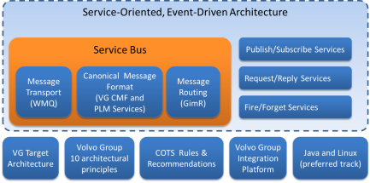
Service Bus
A2 – PLM Architecture Introduction
PLM Target Architecture
Service Provider
Service Consumer
PLM Service Bus
Websphere MQ
GimR Router
Standardised msg formats
Bus Adapter concept
Service Consumer
Service Provider
Service Provider
Notes:
[1] A Service Bus is an architectural pattern used to implement integration between applications in a Service Oriented Architecture.
The main purpose is to decouple applications. By doing so we increase the flexibility to adopt changes.
There will be a number of Service Bus implementations within Volvo. Each Service Bus is a logical implementation within an information domain such as PLM, SCM, CLM and BA. But they are all are based on the same technical platform, the Volvo Group Integration Platform.
For each Service Bus there is an agreement around which connectivity technology to use, how message routing shall be implemented and which information models that shall be used.
[2] For the Service Bus in the PLM domain the message transport is based on Websphere MQ [3], the routing functionality is provided by the lightweight router GimR [4]. It has one internal Volvo Canonical Message Format and another one based on OMG PLM Services 2.0, the latter one is to be used for Commercial Off The Shelf and external partners [5].
Each application providing or consuming services needs a service bus adapter to connect to the bus [6].

Slide 21
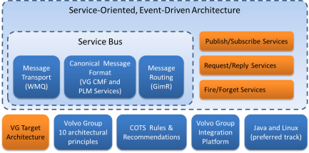
Applications
A2 – PLM Architecture Introduction
PLM Target Architecture
Volvo Group Target Architecture
Domain Driven Design
Single Responsibility Principle
Java/Linux - preferred track
Application
Domain X
Domain Y
Service Bus Adapter
Services exposed by the application
SyncPart
GetVariantExclusions
Notes:
[1] The Service Bus would not be of much use if it wouldn’t be for the applications using it to exchange data.
[2] Applications shall be compliant with the Volvo Group Target Architecture and developed using [3] Domain Driven Design with fine granular domain components.
[4] The applications shall honor the Single Responsibility Principle. That means they should have only one reason to change. Hence we should strive for small applications rather than multi-purpose monolithic applications.
[5] Java/Linux is the preferred platform for applications in the PLM domain.
[6] Applications realize services that are published on the Service Bus.

Slide 22
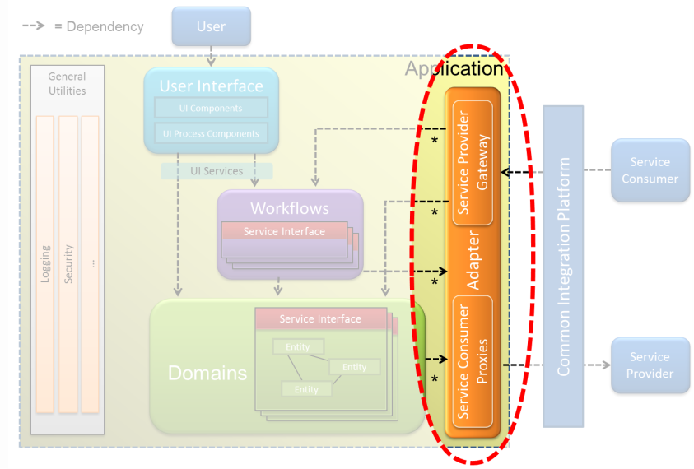

Service Bus Adapter
A2 – PLM Architecture Introduction
PLM Target Architecture
Why?
Application
Adapter
PLM Service Bus
How to implement it?
Using the application’s normal development environment
Developed in Java and deployed separately
Using the Websphere Message Broker
Note! The adapter is always a part of the application.
Notes:
[1]
[2] So, why do we need a service bus adapter?
[3] It is used to connect an application to the service bus so that the application can provide and consume services. The implementation can differ but it should always be considered as an application responsibility.
[4] When selecting how to implement the adapter, use the following priority order:
The Service Bus Adapter should be developed as part of the application’s normal development environment if possible.
If this is not the case, the adapter could be developed in Java and be deployed separately. One example of this is the KOLA adapter.
If this isn’t possible the WebSphere Message Broker may be used.
[5] From a Volvo Group Target Architecture perspective, the service bus adapter is positioned in the orange Proxy-Gateway components where it is taking care of the transformation & value translation functionality.

Slide 23
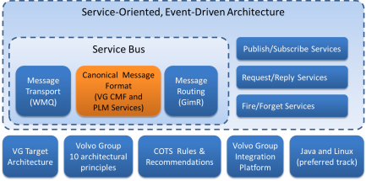
Canonical Data Model
A2 – PLM Architecture Introduction
PLM Target Architecture
Common information model for data on the bus
Some application internals are excluded
Common Language
Notes:
[1] The Service Bus concept includes a so called Canonical Data Model which is a common information model for data that is exchanged on the Service Bus.
The corresponding message format is called a Canonical Message Format or CMF.
[2] The Canonical Data Model grows as more applications are connected to the bus. However, it only contains what other applications need to know.
[3] It is used to harmonize the data that is exchanged on the service bus and acts as the common language.

Slide 24

Canonical Message Formats
A2 – PLM Architecture Introduction
PLM Target Architecture
Volvo CMF Header
KOLA
Volvo CMF body
Volvo CMF Message
SyncPart
SyncPartPLMS
PLM Service Bus
Volvo CMF Header
ProTOM
PDMLink
OMG PLM Services body
PLMS Message
CMF Canonical Message Format
PLMS OMG PLM Services
Read more [7]
Notes:
The use of a Canonical Message Format limits the number of application specific message formats that each application needs to know.
A Canonical Message Format can have several forms and be developed within a specific domain or be an official standard like OMG PLM Services.
The PLM Service Bus has today two Canonical Message Formats. The first format is Volvo specific and should be used for Volvo applications. The second format is based on the OMG PLM Services standard and is to be used for Commercial Off The Shelf applications and external applications
[2] For example if a Volvo developed application such as ProTOM consumes a service from the KOLA application is uses the Volvo Group Canonical Message Format.
[3] But if the Commercial Off The Shelf application PDMLink needs the same data it uses a similar service that uses the OMG PLM Services format instead.
The format of the header is normally the same except the name of the service and so on, but the body part is formatted differently.

Slide 25
Volvo Group Canonical Message Format
A2 – PLM Architecture Introduction
PLM Target Architecture
Volvo Group Message Format
Volvo CMF Header
Message structure
Versioning of message schemas
Id and enumerations
Volvo CMF body
Volvo CMF Message
Namespace for message schemas
Publication of message schemas
Code and Units in XML
Read more [7]
Notes:
[1] The Volvo Group Canonical Message Format is owned by Corporate Process and IT and managed by Volvo Group Integration Office.
The associated guidelines that are published as a WIKI defines the [2] message structure, header structure, error handling and verbs of XML formatted messages as well as [3] versioning of message schemas. It also covers [4] how to manage identifiers and enumerations and [5] how to manage namespaces as well as [6] how and where to publish the message schemas.
The format is influenced by Open Applications Group Integration Specification, OAGIS, but with some simplifications.

Slide 26

Canonical Message Format Based on OMG PLM Services
A2 – PLM Architecture Introduction
PLM Target Architecture
OMG PLM Services
Volvo CMF Header
OMG PLM Services body
Informational Model
Computational Model
Volvo PLMS Message
Based on STEP AP214
Services are specified as WebServices.
Read more [8]
PLMS OMG PLM Services
Notes:
[1]The OMG PLM Services specification defines an [2] Informational model to represent the product data and a [3] Computational model to query and navigate the product data.
In the standard, services are derived from the combination of the informational model and computational model that allows creating, reading, updating, and deleting the product data and are realized as WebServices. [4] This is not compliant with the Volvo Group target Architecture. Therefore services on the PLM Service Bus represent the product data using the information model XML schema of OMG PLM Services but not the Computational Model schema. Instead the header of the Volvo Group Message Format is used.

Slide 27
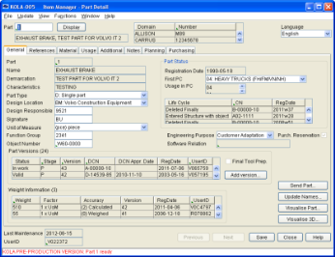
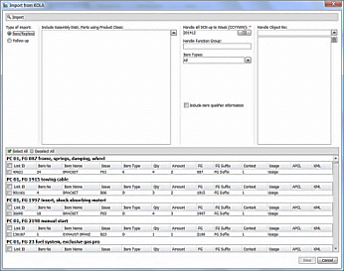

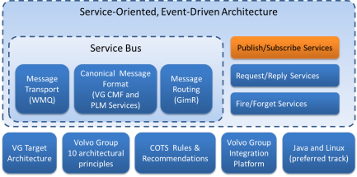
Publish/Subscribe Services
Application 2
Application 1
Batchfile
Save
Application 3
KOLA
ProTOM
EDB
Once /day
PLM Service Bus
SyncPart Service
Notes:
Today many integrations are performed by sending large files that are created once a day.
Hence, it takes one day for a change in the source application to be available in the downstream application.
[2] One alternative is to use a publish-subscribe pattern. Applications that want to receive messages subscribe to the service by means of a configuration in the router.
[3]-[6] The sending application sends the messages to the router and the router distributes them to all applications that have subscribed to that particular message type or service. The subscription can include a filter to only receive for example part messages of a certain type.
This has several benefits, the obvious one is time since the change is distributed more or less immediately.
The second one is loose coupling between the provider and the consuming applications since they do not have to know about each other. It is also easy to add on more subscribers, so called service consumers.

Slide 28
Message Example – SyncPart Service (Volvo CMF)
...
<ns3:Part>
<ItemNumber>22210411</ItemNumber>
<Domain id="VO"/>
<ItemCategory>Part</ItemCategory>
<ItemType id="D"/>
<Characteristics></Characteristics>
<Created>
<UserId>V028723</UserId>
<Date>2013-06-13+02:00</Date>
</Created>
<DesignLocation id="SE"/>
<DesignResponsible>9113</DesignResponsible>
<LastMaintained>
<UserId>A028167</UserId>
<Date>2013-06-24+02:00</Date>
</LastMaintained>
<MasterSystem id=""/>
<Description language="en-US">BRACKET</Description>
...
<Version>
<Status id="10"/>
<VersionIsValid>false</VersionIsValid>
<Created>
<UserId>V028723</UserId>
<Date>2013-06-13+02:00</Date>
</Created>
<DesignChangeNote>
<DCNNumber>E2340117</DCNNumber>
...
</Version>
</ns3:Part>
...
Notes:
Here is an example of a message in Volvo Canonical Message Format.
It is an extract of a SyncPart publish subscribe message that KOLA sends whenever a part is created or changed.
This particular service is in production and KOLA sends around 50 000 of these messages every week.

Slide 29
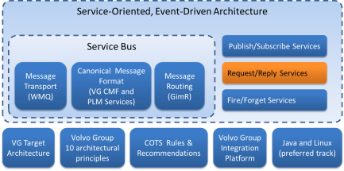
Request/Reply Services
A2 – PLM Architecture Introduction
PLM Target Architecture
KOLA
ProTOM
PLM Service Bus
Notes:
The application that want to use a service is called a consumer of the service and the application that exposes the service is called the service provider.
In this example the application ProTOM wants to use a KOLA service that performes a breakdown of the product structure to get a resolved bill of material for a prototype.
It all starts when ProTOM initiates the request, the service bus adapter transforms the request from the internal format to the canonical message format and puts a request message on the bus with the correct metadata so that it can be routed to the correct application, KOLA in this case. When the message is recieved by the KOLA adapter it is transformed from the canonical message format to the KOLA internal copy book format and the request is processed by the KOLA Mainframe server.
When the response is ready the KOLA adapter transforms the internal format to the canonical message format and sends the response message directly to the service consumer ProTOM unlike the request.
Note that for big messages, the transport of data takes a big portion of the time.

Slide 30
What is PLM?
PLM Target Architectrure
Transition from As-Is to To-Be
The Business Challenges and Strategy

Slide 31
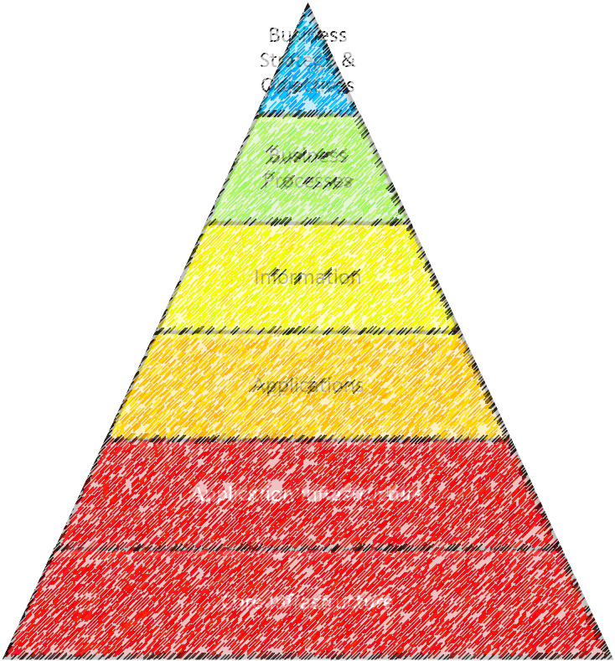
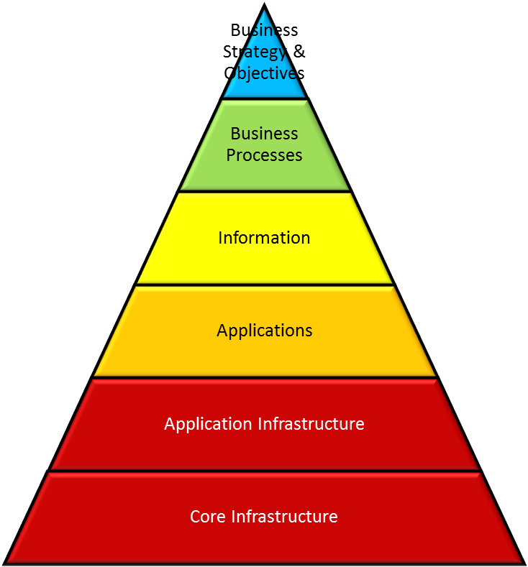
Stepwise Transition from AS-IS to TO-BE
A2 – PLM Architecture Introduction
Transition from AS-IS to TO-BE
Transition
AS-IS
TO-BE
Notes:
The transition, from where we are today to where we want to be tomorrow, requires changes on many layers in the Enterprise Architecture pyramid.
It is not just to rewite or purchase applications replacing the old ones. Nor is it all about implementing services or pure process changes.
Starting with the business strategy and challenges the critical business capabilities form the PLM Target Architecture. This will lead to changes on both processes and IT solutions. The transition needs to be done in increments and with continous assesment of Business Value and changes in TO-BE.

Slide 32

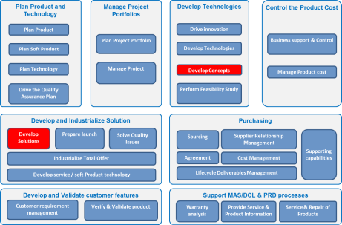
Example: Prototype Domain
A2 – PLM Architecture Introduction
Transition from AS-IS to TO-BE
Business Strategy and Supporting Capabilities
PROTUS
KOLA
ProTOM
KOLA
Test Object Mgmt
Product Stucture Breakdown
Product Stucture Breakdown
Test Object Mgmt
Product Stucture Breakdown
Test Object Planning
Test Mgmt
Test Object Planning
BOSS
PROTUS
Issue Reporting
Prototype Loan Mgmt
Issue Reporting
Prototype Loan Mgmt
AS-IS
TO-BE
Notes:
Let us look at the Prototype area and take it as an example of what the transition from AS-IS to TO-BE architecture can look like.
[1] Today PROTUS is used to manage the Test Objects, perform Issue Reporting and more. The application is not compliant with the target architecture and it has not been built with Domain Driven Design. It is hard to support new business demands and the solution is hard to maintain. It includes complex logic that performs breakdown of the Product Structure to a bill of material, [2] logic that KOLA actually is responsible for. [3] BOSS is an application managing loans of test equipment and test objects. It uses the same database as PROTUS.
[4] Group Trucks technology performed a pre-study of the Prototype domain. By taking the business strategy and the supporting capabilities as input and applying the PLM Target Architecture, several improvements was identified.
It was decided to create a [5] new application called Protus Test Object Management or ProTOM. It should have [6] fine grained Domain Components inside the application. [7] The product structure breakdown logic should be extracted. A service provided by KOLA should be used instead of duplicating this functionality. [8] The Issue Reporting functionality that is a generic functionality should be kept in PROTUS. On the other hand [9] the Prototype Loan Management functionality that used to be managed by the BOSS application should be implemented as Domain Component within ProTOM. All in all this results in [10] applications with clear responsibilities and [11] the internal application architecture is improved.
[12] By letting ProTOM subscribe to publish/subscribe services exposed by KOLA on the service bus, data is kept up to date.
Last but not least, [13] the use of asynchronous messaging in the integrations, makes ProTOM loosely coupled to other applications and therefore not directly dependent on the other applications uptime.

Slide 33
Example: First set of Services Implemented for KOLA
A2 – PLM Architecture Introduction
Transition from AS-IS to TO-BE
Notes:
Did you know that KOLA has exposed a set of both publish subscribe and request/reply services and that ProTOM, TEXAS and TASR are the first consumers.
14 of these services are in production as of april 2014, the rest are planned to be in production during Q2 2014.

Slide 34
Challenges Found During Service Implementation in KOLA
A2 – PLM Architecture Introduction
Transition from AS-IS to TO-BE
Publish/Subscribe Services
Request/Reply Services
To identify the set of services and event triggers
Scope of event messages
Initial load for consumers
Error detection and recovery for consumers
Complex business logic – hard to understand how to use some of the services
OMG PLM Services Standard
High Complexity
Many mapping options
Not 100% compliant with KOLA Logic
Properties cannot be associated to all objects
Values Sets are not easily managed
Canonical Msg Format
Harmonization and consistency
Backward compatibility of schema versions
Notes:
During the implementation of services for KOLA a number of challenges were found
They are categorized in four categories.
[1] Publish/Subscribe Services
[2] One of the hardest parts of implementing publish/subscribe services is to identify which services to implement and which events to trigger on.
[3] What is the service responsible for keeping updated in the event message? Can the consumer understand what is the scope of the service and what is just related information that is updated by other event services. Should we include all data of a business object including history, or just the latest version or perhaps only the change itself? To simplify sequence handling and error recovery you want the event messages to carry enough data to replace what was earlier imported by the consumer and not only the change.
[4] New publish/subscribe service consumers need to pre-load their cache. Ultimately this pre-load should use the same message format and mechanism as the event messages. However, in many cases those messages would be huge and challenging to produce in the required timeframe.
[5] To find mismatches between KOLA and a consumer’s cache can be tricky. Recovery strategy will be unique for each solution.
[6] Request-Reply Services
[7] Due to the complex business logic it is hard for consumers of some of the services to understand how to use them.
[8] Canonical Message Format
[9] Harmonization and a consistency between services requires a centralized effort.
[10] When designing the message schemas it can be tricky to secure backwards compatibility.
[11] OMG PLM Services standard
[12] The standard is based on STEP AP214 and has a very rich and generic data model. It often uses many objects and relations to represent a single Volvo object. This results in complex XML messages with a lot of references in the message.
[13] Often there are many mapping options which makes it hard to secure consistency between the mapping that we have chosen and the mappings done in different COTS products.
[14] Many constructs in KOLA do not map well.
[15] It is not possible to attach properties to all objects and it is not always possible to set good names for properties on objects so that the message is understandable.
[16] There is a construct for Value sets in the PLM Services standard, PLIB, but is complex and not applicable to all objects.

Slide 35
References
A2 – PLM Architecture Introduction
Transition from AS-IS to TO-BE
Reference |  | Address
[1] | Corporate Process & IT – DVP Enterprise Architecture | https://teamplace.volvo.com/sites/CPIT-Committees/DVP-EA/SitePages/HomePage.aspx
[2] | Corporate Process & IT – Enterprise Architecture | http://teamplace.volvo.com/sites/enterprise-architecture
[3] | Volvo Group 10 Architectural Principles | http://teamplace.volvo.com/sites/enterprise-architecture/Target%20architecture%20and%20Principles/Forms/AllItems.aspx
[4] | COTS Rules & Recommendations | http://teamplace.volvo.com/sites/enterprise-architecture/Rules%20Policies%20%20Guidelines
[5] | Volvo Group Integration Platform | http://teamplace.volvo.com/sites/volvo-group-integration-office/VGIO%20Subpages/Platform.aspx
[6] | Selection of Development Track for an IT Solution | http://teamplace.volvo.com/sites/enterprise-architecture/Rules%20Policies%20%20Guidelines/Development%20Track%20Selection%20Rules%20and%20Guidelines.ppt
[7] | Volvo Group Message Format | http://confluence.it.volvo.net/display/VOLCMF/Volvo+Group+Message+Format
[8] | OMG PLM Services | http://www.omg.org/spec/PLM/
Notes:
You can read more about most of what we have talked about in this course. Just click on the link that you are interested in.
This was all about PLM Architecture. Thank you for taking this e-learning!

